Slide 1
PowerTeacher Pro for Teachers
Part One
Notes:
Last updated: 1/5/17 (for PS 10.1 release)

Slide 2
Agenda
Getting Started
Setting Up PowerTeacher Pro
Working with Assignments
Scoring Assignments
Time for Review
Notes:
enter notes

Slide 3
Getting Started
Notes:
enter notes

Slide 4
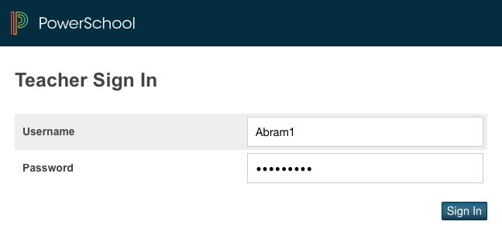
Signing In
Address https://portal.bixbyps.org/teachers/pw.html
Your username and password

Slide 5
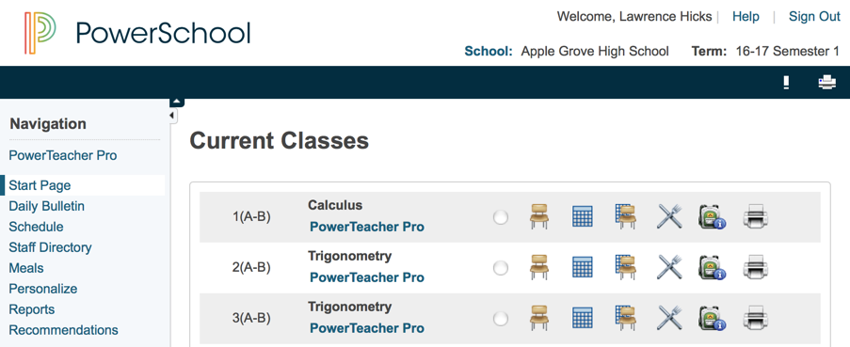
Navigating to the Gradebook
Teachers navigate to the HTML-based gradebook directly through the teacher portal.
PowerTeacher > PowerTeacher Pro

Slide 6
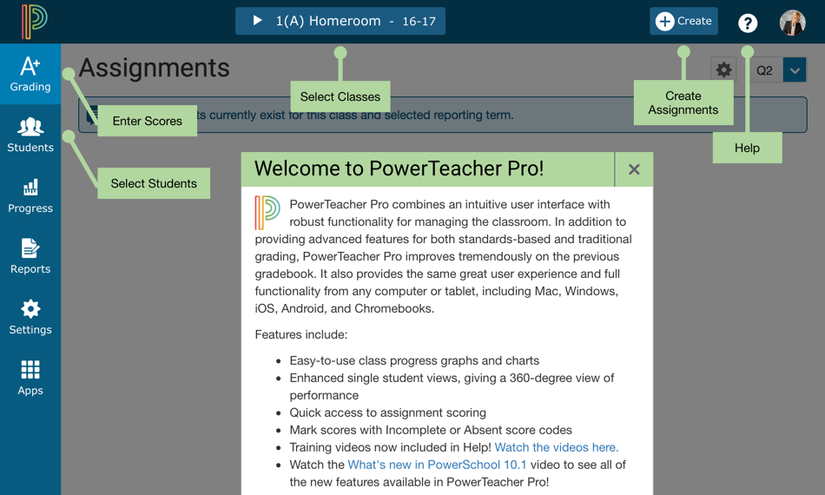
Welcome to PowerTeacher Pro
Become familiar with the features of PowerTeacher Pro.
Help > Getting Started

Slide 7
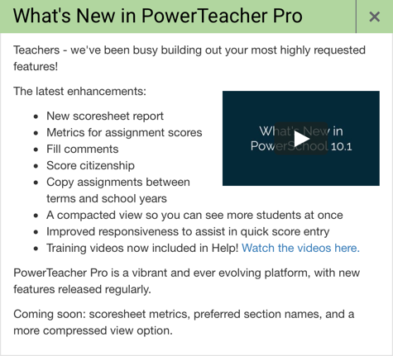
View What’s New
View a list of new features, watch a video on what’s new, and access training videos on how to use PowerTeacher Pro.
Help > What’s New?

Slide 8
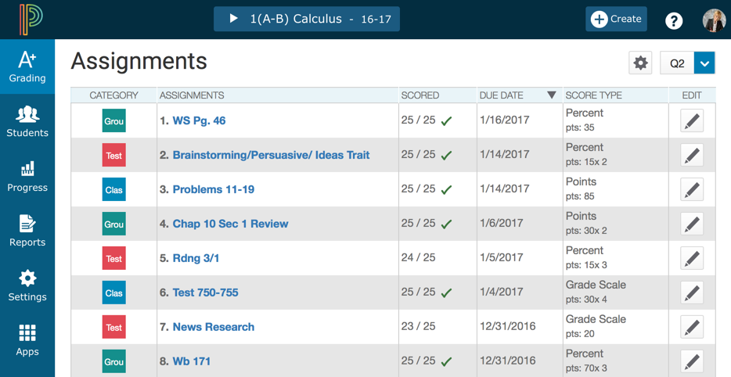
Explore the Gradebook
PowerTeacher > PowerTeacher Pro

Slide 9
Setting Up PowerTeacher Pro

Slide 10
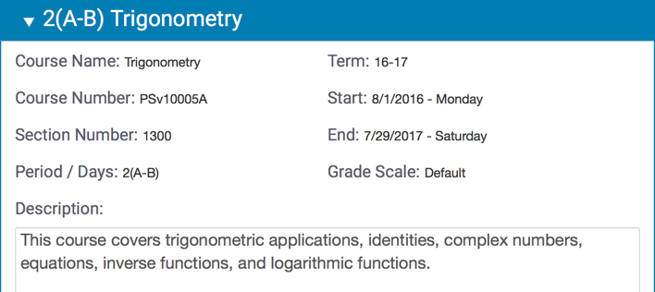
Viewing and Adding Class Descriptions
View class details and add a customized description or syllabus.
Settings > Class Descriptions

Slide 11
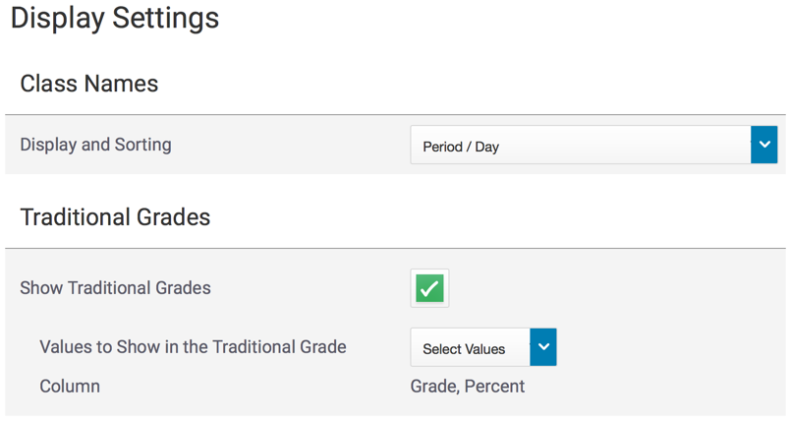
Setting Up Display Preferences
Customize the display settings to control how information appears in your gradebook.
Settings > Display Settings

Slide 12
Using the Accessibility View
Enable a larger view of PowerTeacher Pro.
Select your name > Enable Accessibility View

Slide 13
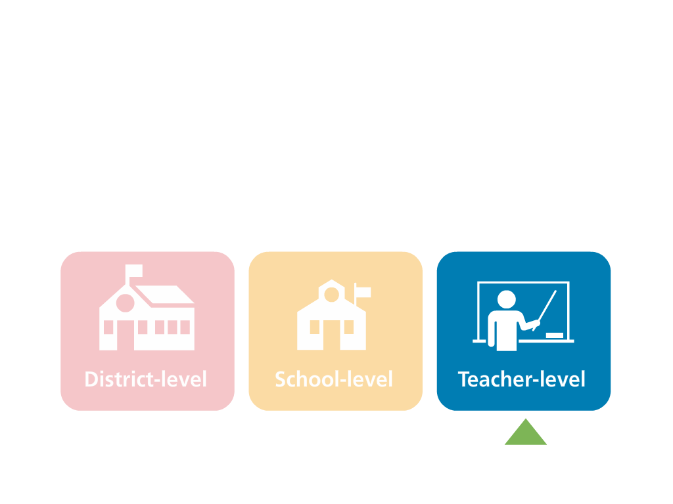
Teacher-Level Grading Preferences
Teachers may configure traditional grade calculations for each section they teach, and may have access to edit weights and dropped score preferences
Teachers may configure standards grades calculations for each section they teach

Slide 14
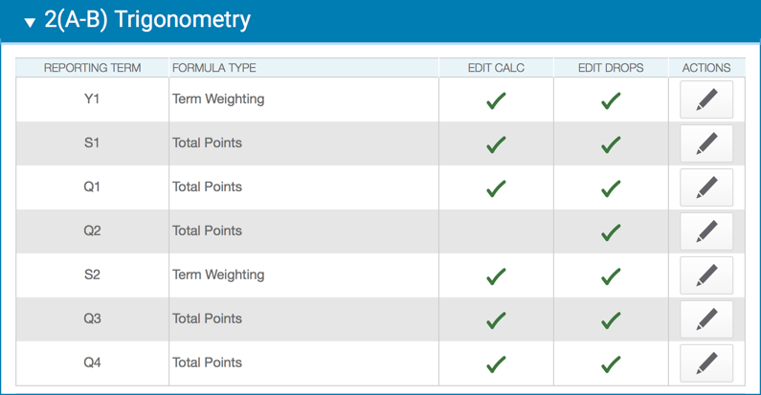
Traditional Grade Calculation Settings
For each class, configure traditional grade calculations for each reporting term (permission to edit required from the district or school).
PowerTeacher Pro > Settings > Traditional Grade Calculations

Slide 15
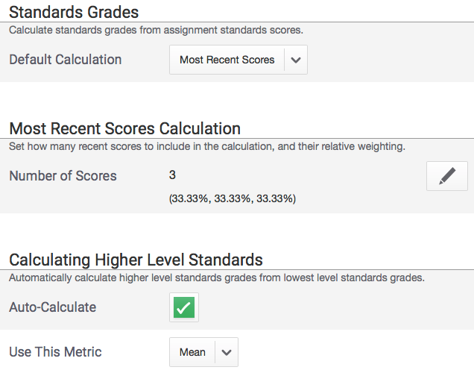
Standards Grade Calculation Settings
For each class, configure standards grades calculations (permission to edit required from the district or school).
Mean
You will use Mean if you want to average your standards based assignments
If using Mean, don’t sent anything here
PowerTeacher Pro > Settings > Standards Grade Calculations

Slide 16
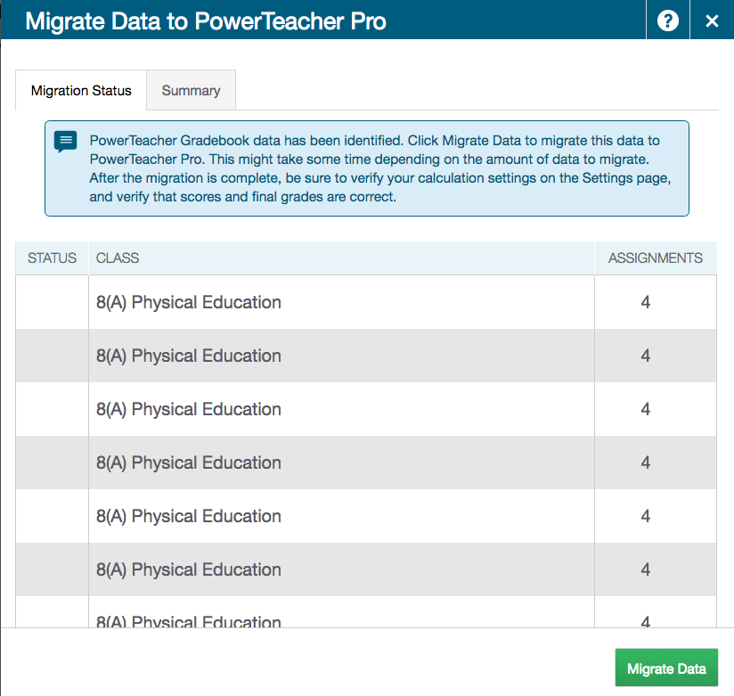
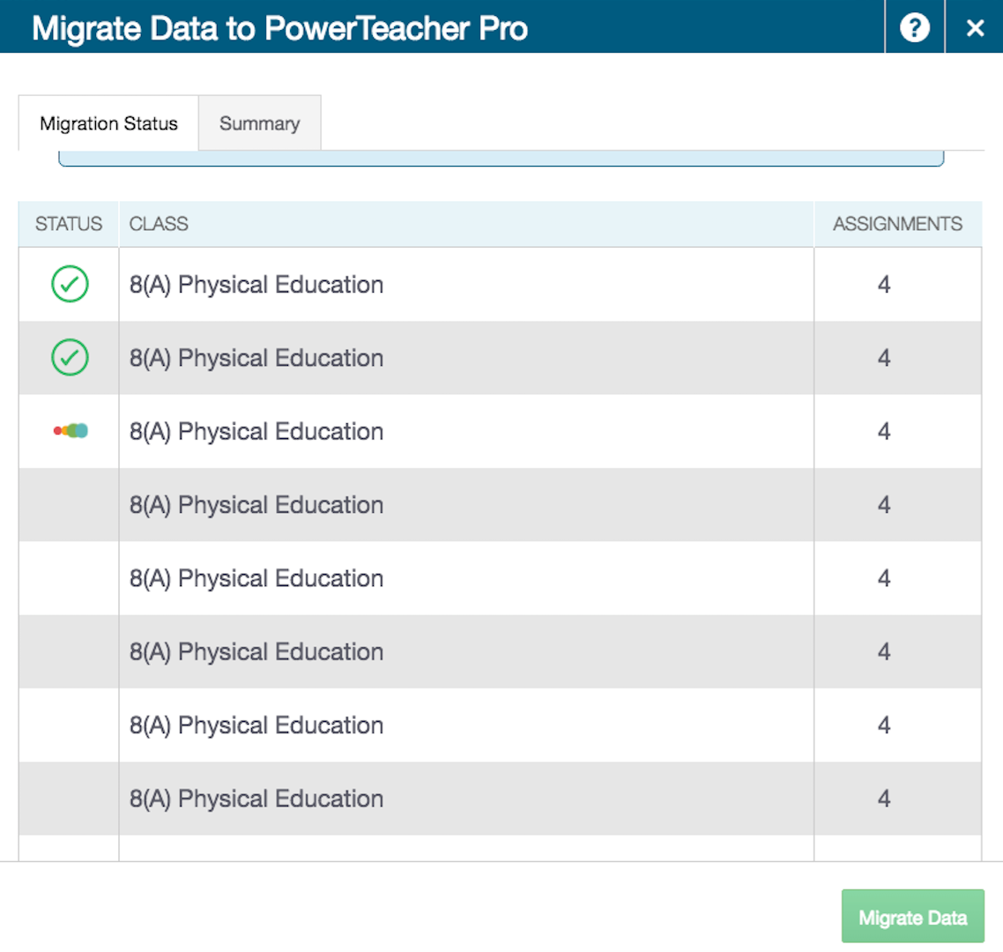
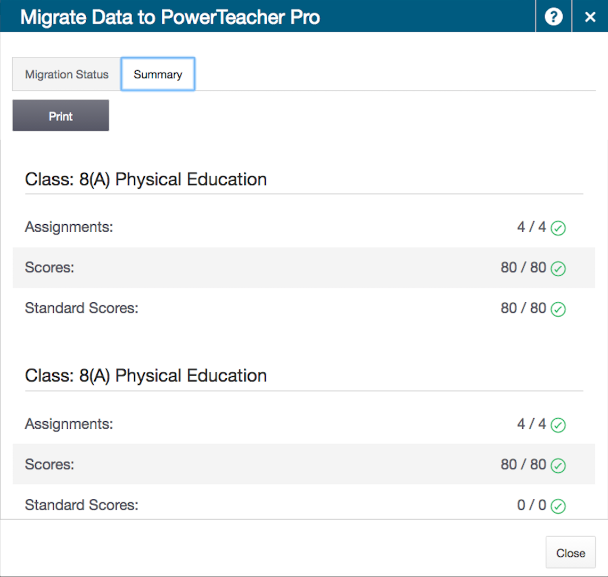
Data Migration
Current-year data will be migrated from PowerTeacher Gradebook to PowerTeacher Pro.
PowerTeacher > PowerTeacher Pro

Slide 17
Working with Assignments
Notes:
enter notes

Slide 18
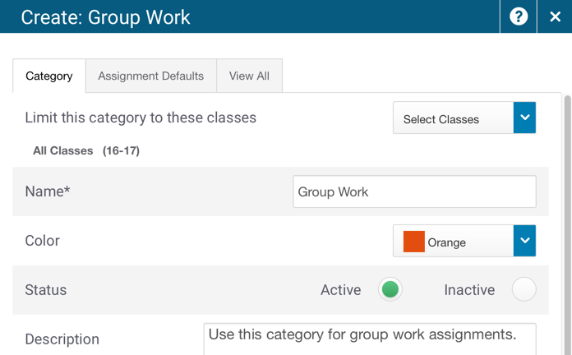
Creating Categories
Use categories to group assignments by type
Use categories created at the district level
Create and edit your own categories
Create > Category

Slide 19
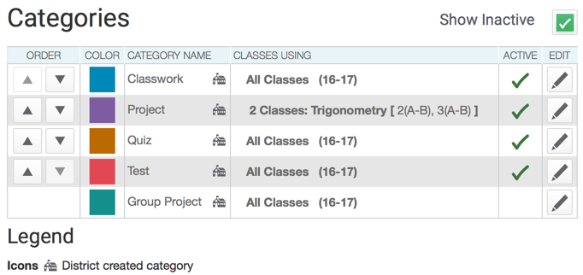
Viewing and Editing Categories
Sort the list of categories
View district-created categories
Edit a category
Grading > Categories

Slide 20
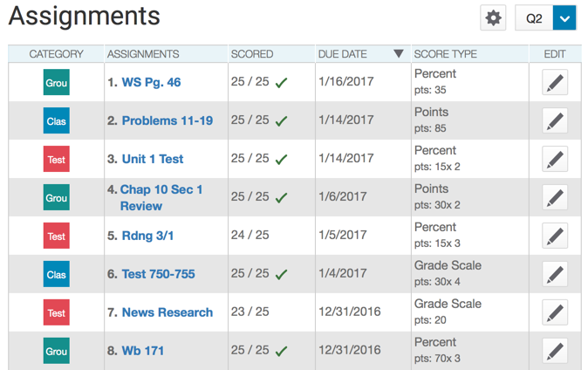
Viewing the Assignment List
Grading > Assignment List

Slide 21
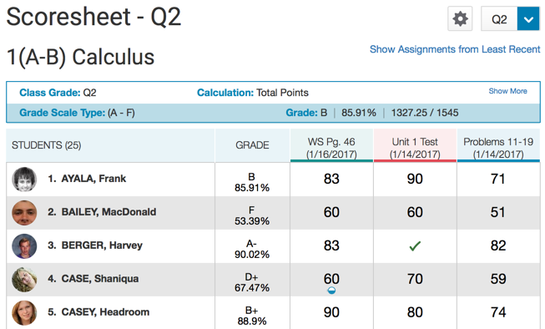
Viewing the Scoresheet
Grading > Scoresheet > Show Assignments from Most Recent

Slide 22
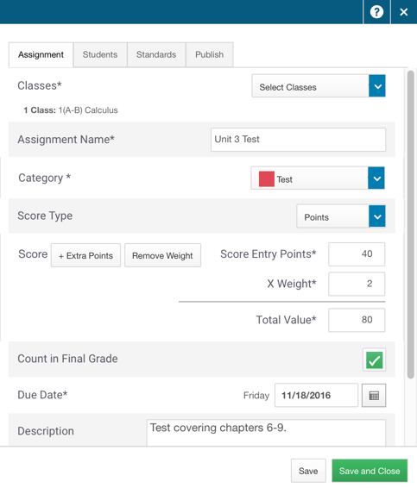
Creating Assignments
Create an assignment for one, some, or all of your students or classes
Align standards to an assignment
Define when an assignment is published
Create > Assignment

Slide 23
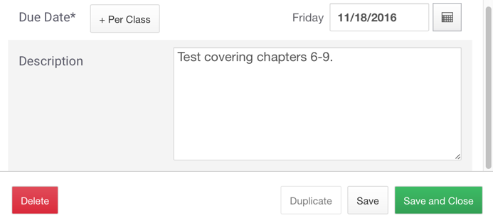
Duplicating Assignments
Duplicate new or existing assignments
Duplicate assignments for multiple classes
Use different due dates for different classes
Grading > Assignment List > Edit icon > Duplicate

Slide 24
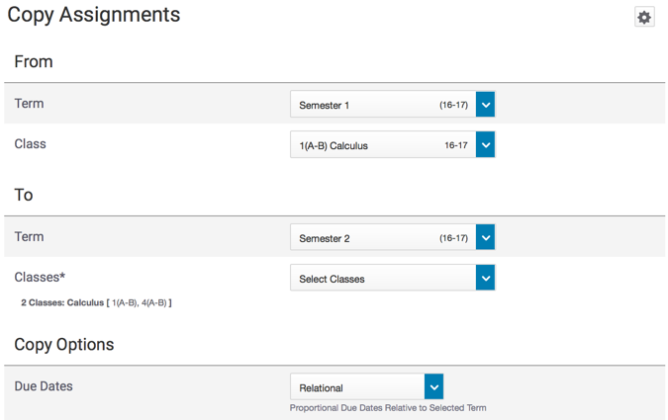
Copying Assignments
Copy one, some, or all of the existing assignments in a selected term and class to other terms and classes.
Assignment List or Scoresheet > Gear icon > Copy Assignments

Slide 25
Scoring Assignments
Notes:
enter notes

Slide 26
Entering Scores: Options
Mark or score assignments using the following options:
Direct entry
Score Inspector
Flags (score indicators)
Special codes
Hot keys (keyboard shortcuts)
Comments
Fill scores, flags, and comments

Slide 27
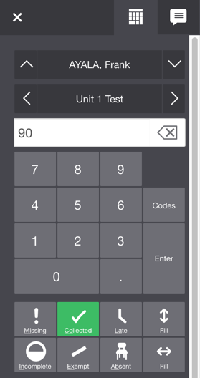
The Score Inspector
Why use the Score Inspector?
Enter and edit scores
Fill scores
Enter comments
Fill comments
Use flags (missing, collected, late, incomplete, exempt, and absent)
Use special codes
Grading > Scoresheet > (select a score cell)

Slide 28
Fill Scores
Fill students’ scores for one assignment
Fill all assignment scores for one student
Grading > Scoresheet > (select a score cell)

Slide 29
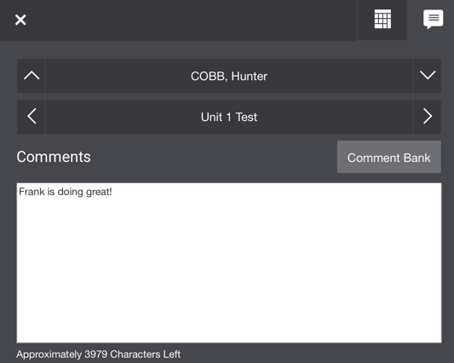
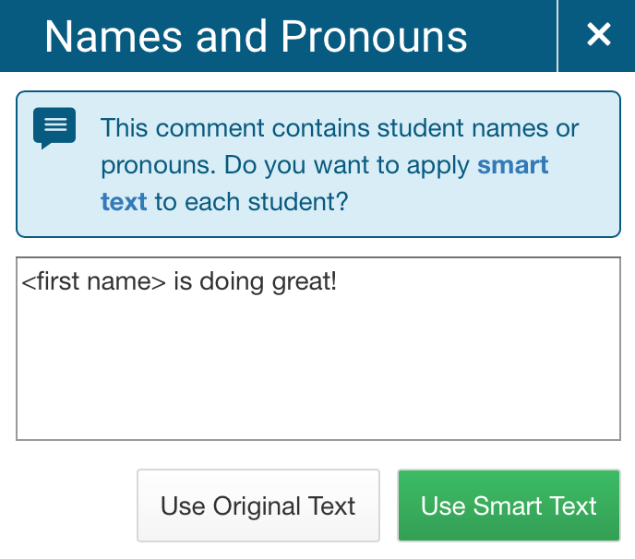
Add Comments
Enter comments manually or use the comment bank
Use the smart text feature to personalize comments for one or more students
Enter a student’s name, then fill the comment to all empty cells to trigger the smart text function.
Grading > Scoresheet > (select a score cell) > Comment icon

Slide 30
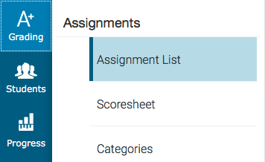
Marking Assignments: Methods
Mark or score assignments using the following methods:
Score a single assignment on the Assignments page
Use the Scoresheet to score multiple assignments
Grading > Assignment List (or) Scoresheet

Slide 31
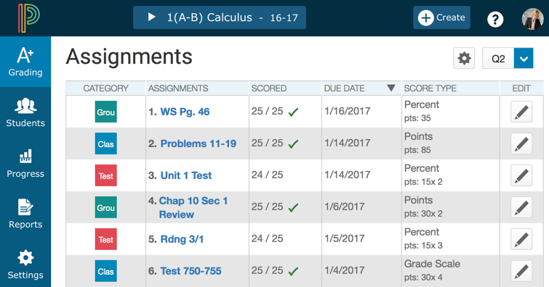
Question 1
Where do you click to add a new assignment?
}
#1
{
#2

Slide 32
Answer 1
Where do you click to add a new assignment?

Slide 33
Question 2 - Matching
Match the flag or icon with its definition.
A
1
Indicates that an assignment is exempt
Answer 1
B
2
Indicates that an assignment is incomplete
Answer 2
C
3
Indicates that a comment was added
Answer 3
D
4
Indicates that an assignment is late
Answer 4

Slide 34
Answer 2 - Matching
Match the flag or icon with its definition.
A
1
Indicates that an assignment is exempt
B
2
Indicates that an assignment is incomplete
C
3
Indicates that a comment was added
D
4
Indicates that an assignment is late

Slide 35
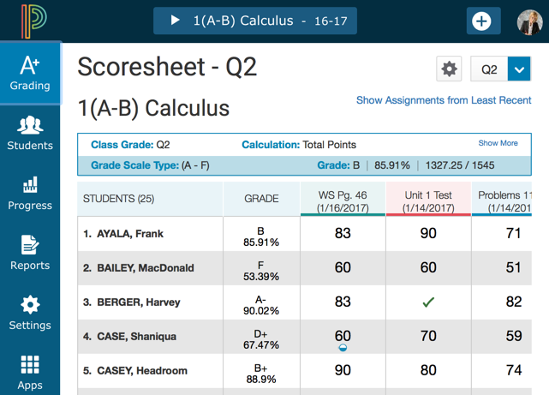
Question 3
Where do you click in PowerTeacher Pro to begin the process of adding a class description?

Slide 36
Answer 3
Where do you click in PowerTeacher Pro to begin the process of adding a class description?

Slide 37
Question 4
Which of the following options can you use to save time when creating assignments?
A
B
Duplicate existing assignments
Create assignments for course groups
C
D
Create assignments for all classes
Copy assignments across terms

Slide 38
Answer 4
Which of the following options can you use to save time when creating assignments?
A
B
Duplicate existing assignments
Create assignments for course groups
C
D
Create assignments for all classes
Copy assignments across terms

Slide 39
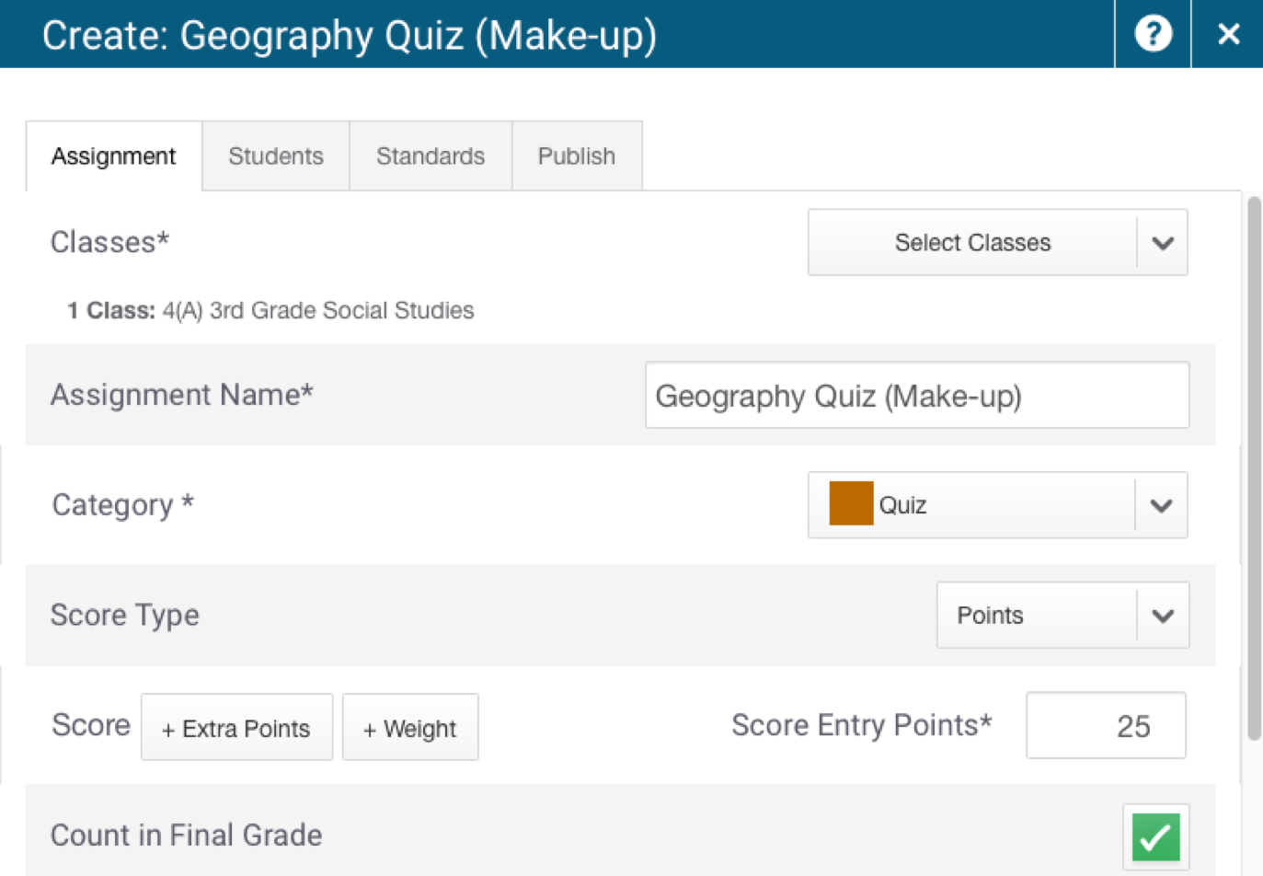
Question 5
Where do you click to apply an assignment to a selection of students?

Slide 40
Answer 5
Where do you click to apply an assignment to a selection of students?

Slide 41
Key Points
Getting Started – Navigate to the gradebook directly from the teacher portal
Setting Up PowerTeacher Pro – Add class descriptions, configure how information appears in your gradebook, and edit grading preferences
Working with Assignments – Create assignment categories and apply them to single or multiple assignments, create assignments, and copy assignments
Scoring Assignments – Use a variety of options and methods to score assignments
Notes:
enter notes

Slide 42
Copyright © 2017 PowerSchool

